Slide 1
British Airways
Customer Insights & Marketing Informatics Report

Slide 2
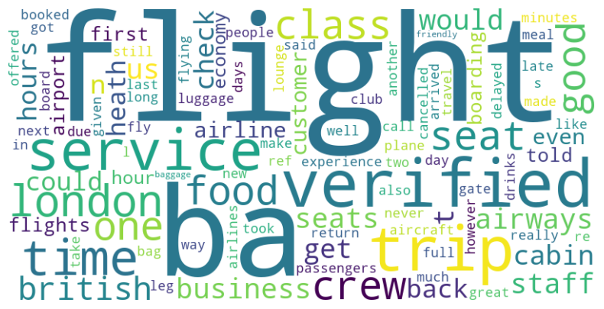
Analysis of Recent British Customer Evaluations
The study sampled 1,000 online customer evaluations for the BA the distribution of sentiment was as follows:
56% Favourable Reviews
43% Unfavourable Reviews
2% indifferent/Neutral Reviews
Based on this data, we calculated a Net Promoter Score of 13.4%. A Net Promoter Score in this range is generally considered poor and an area of concern.
Focus areas: flights to/from Britain. And a lot of Business trips. Equal feedback on premium and economy cabins. Decide whether to maintain balanced approach or prioritize one cabin class going forward based on business strategy. Improving key airports, routes, and aligned product/service enhancements crucial

